Slide 1
تمرین پنجم مدار منطقی

Slide 2
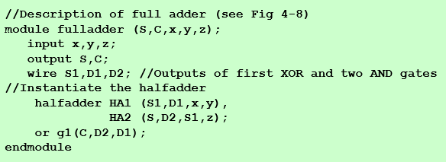

Slide 3






Slide 4

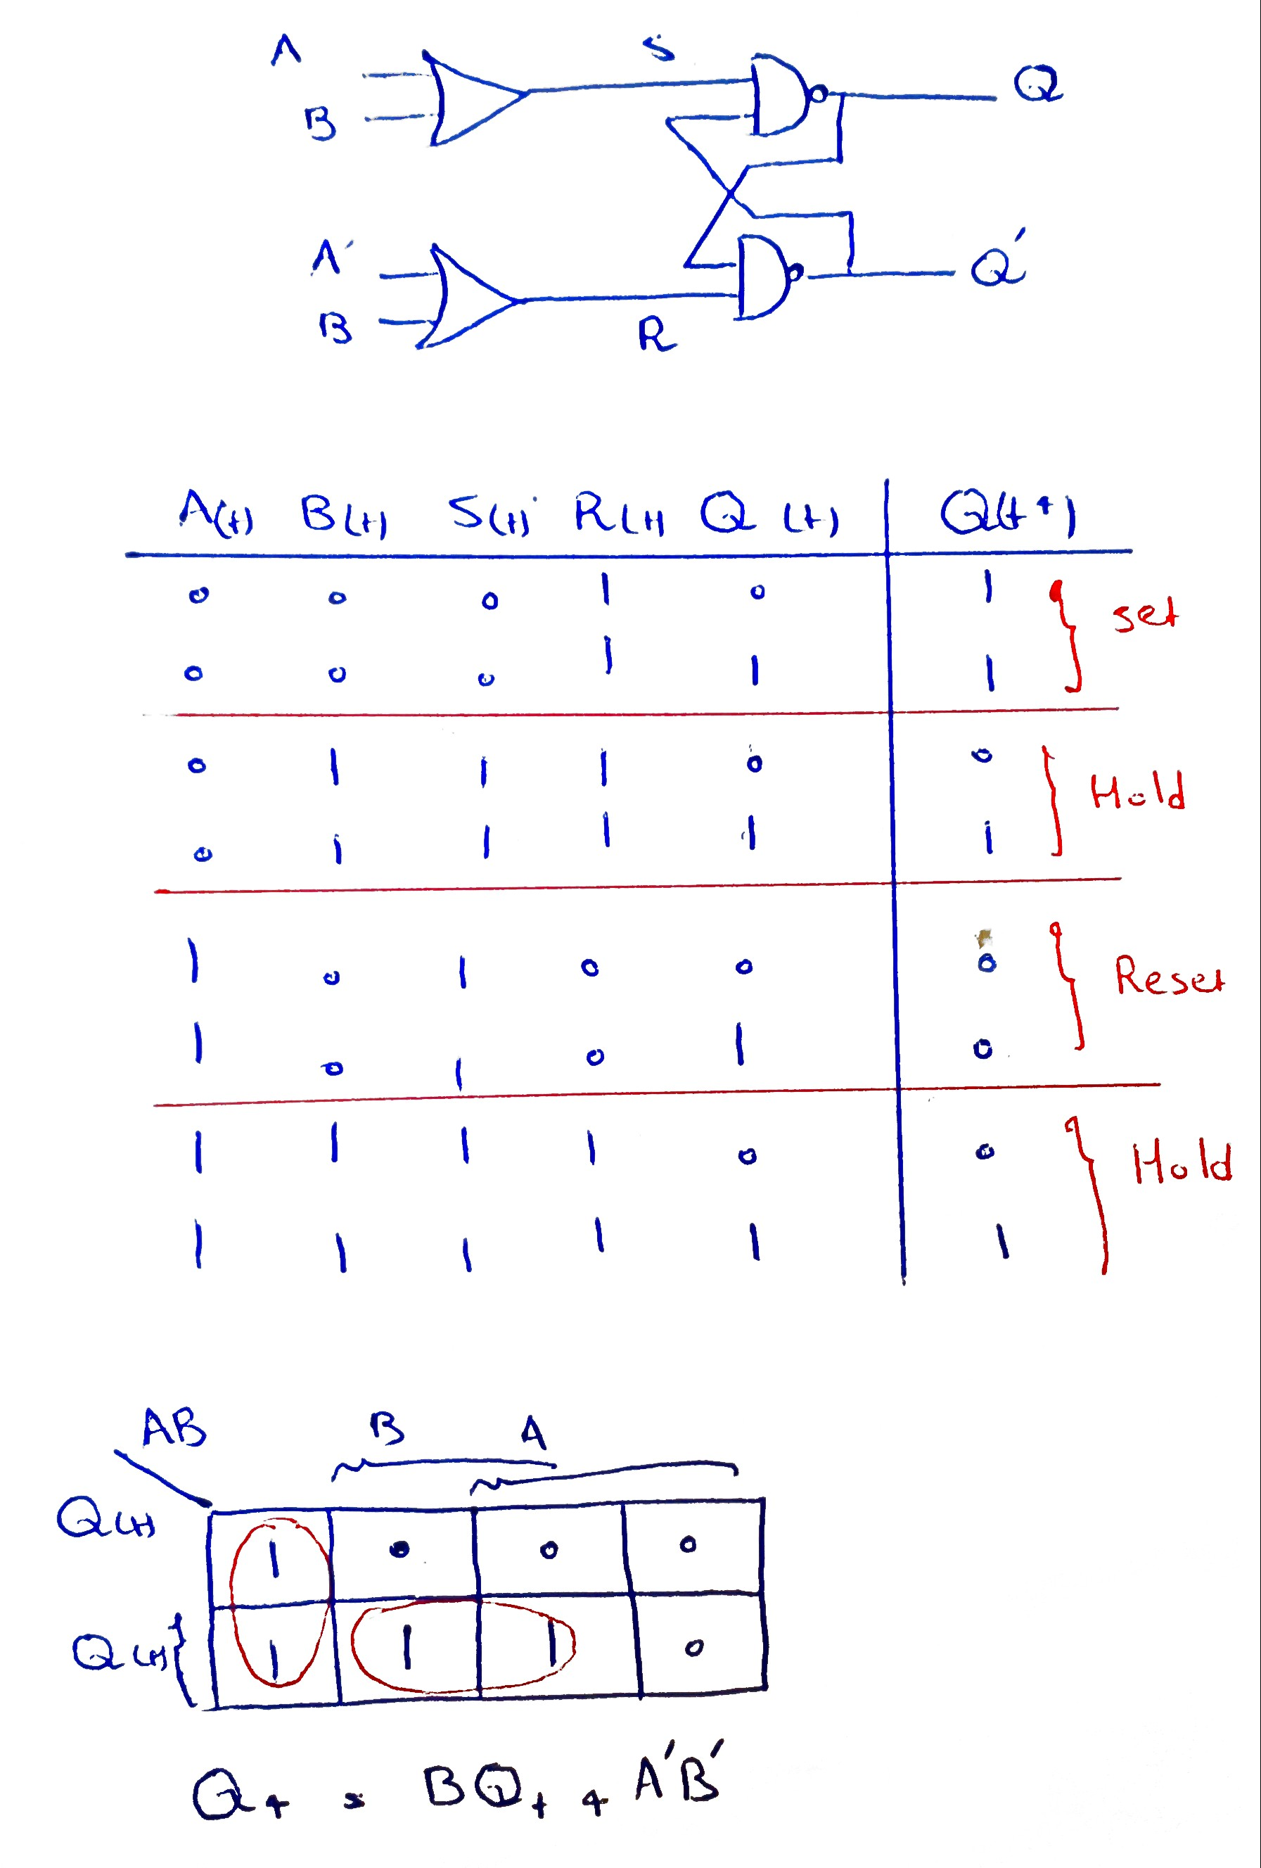
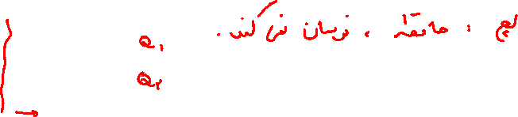

Slide 5
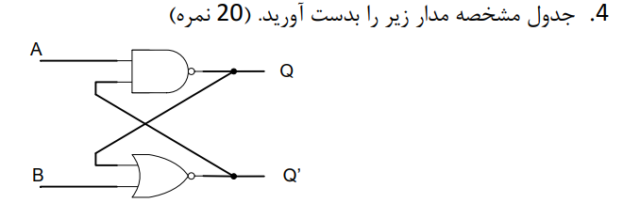
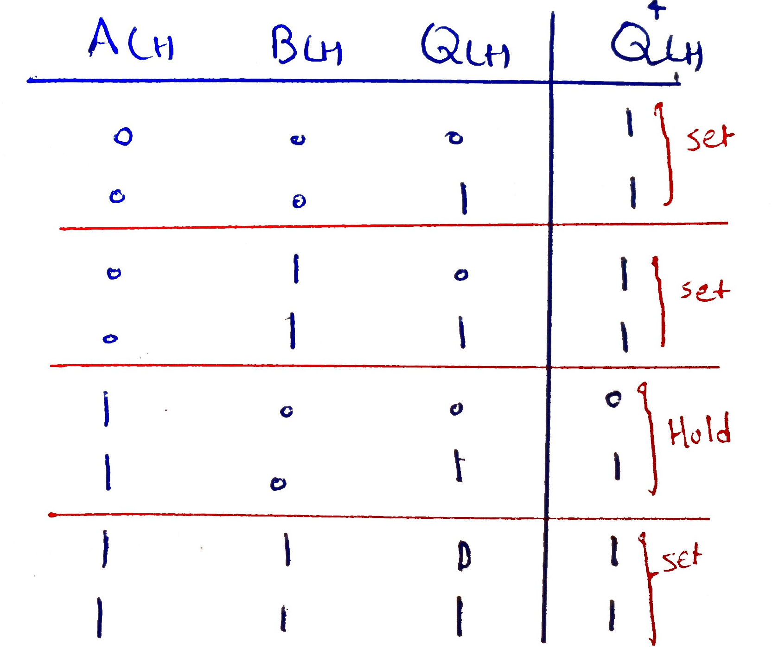
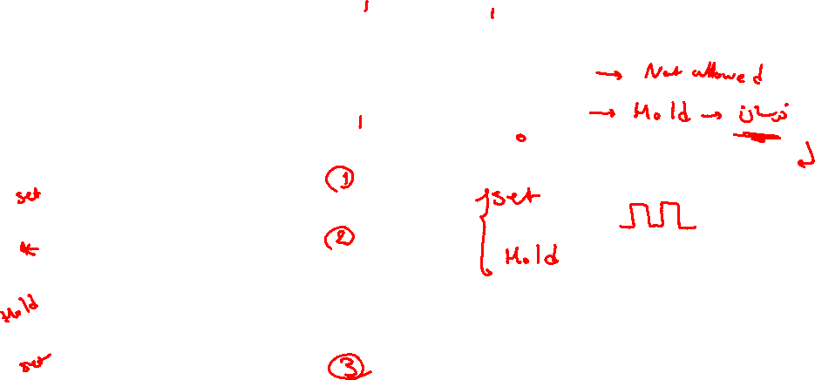

Slide 6
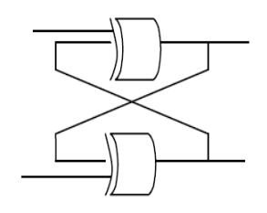

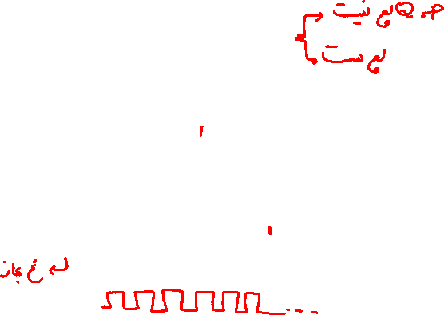




Slide 7

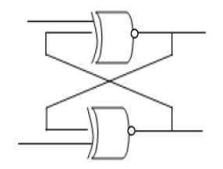
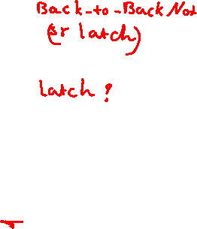


Slide 8
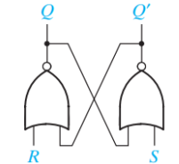
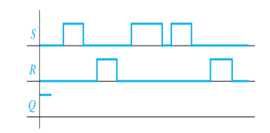
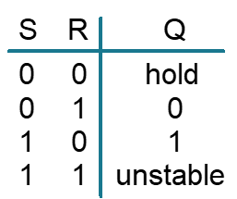

Slide 9

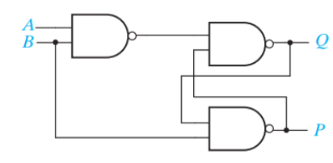



Q(t) | P(t) | A(t) | B(t) | C(t) | Q(t+1) | P(t+1)
0 | 0 | 0 | 0 | 1 | 0 | 1
0 | 0 | 0 | 1 | 1 | 1 | 1
0 | 0 | 1 | 0 | 1 | 0 | 1
0 | 0 | 1 | 1 | 0 | 1 | 0
0 | 1 | 0 | 0 | 1 | 0 | 1
0 | 1 | 0 | 1 | 1 | 0 | 1
0 | 1 | 1 | 0 | 1 | 0 | 1
0 | 1 | 1 | 1 | 0 | 1 | 0
1 | 0 | 0 | 0 | 1 | 0 | 1
1 | 0 | 0 | 1 | 1 | 1 | 0
1 | 0 | 1 | 0 | 1 | 0 | 1
1 | 0 | 1 | 1 | 0 | 1 | 0
1 | 1 | 0 | 0 | 1 | 0 | 1
1 | 1 | 0 | 1 | 1 | 0 | 0
1 | 1 | 1 | 0 | 1 | 0 | 1
1 | 1 | 1 | 1 | 0 | 1 | 0

Slide 10
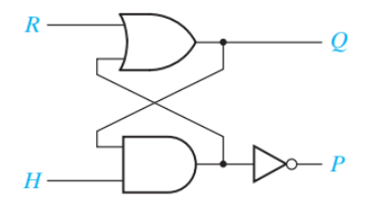
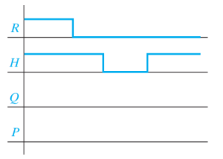
R | H | Q | P | Q+ | P+
0 | 0 | 0 | 0 | 0 | 1
0 | 0 | 0 | 1 | 0 | 1
0 | 0 | 1 | 0 | 0 | 1
0 | 0 | 1 | 1 | 0 | 1
0 | 1 | 0 | 0 | 1 | 1
0 | 1 | 0 | 1 | 0 | 1
0 | 1 | 1 | 0 | 1 | 0
0 | 1 | 1 | 1 | 0 | 0
1 | 0 | 0 | 0
1 | 0 | 0 | 1
1 | 0 | 1 | 0
1 | 0 | 1 | 1
1 | 1 | 0 | 0 | 1 | 0
1 | 1 | 0 | 1 | 1 | 0
1 | 1 | 1 | 0 | 1 | 0
1 | 1 | 1 | 1 | 1 | 0

Slide 11
